Slide 1
2 RoTATION MANIPULATOR 8051 MICROCONTROLLER
DONE BY
Yogeeshwar s 18bec1343
B s vishwath kumar 18bec1289

Slide 2
INTRODUCTION
Manipulators with free joints are typically actuated mechanisms. In this project, we analyse the 2 link manipulator’s end effect and implement it with the help of 8051, keil uvision, proteus and scilab and find the deviation between the calculated and the actual values of the end effect.
OBJECTIVES
Detect the input from the keypad (input points(X,Y))
Parallelly display the given point on the LCD panel.
To actuate the servos according to the given input points.
To observe the end effect of the 2R manipulator and hence calculate the deviation from the calculated value.

Slide 3
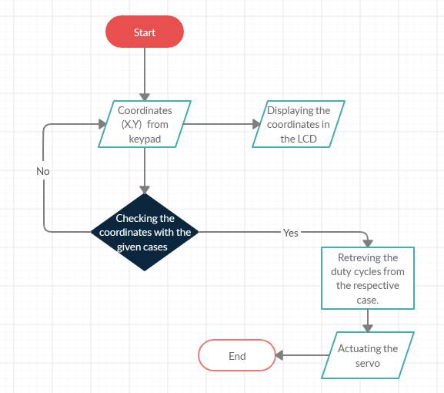
flowchart

Slide 4
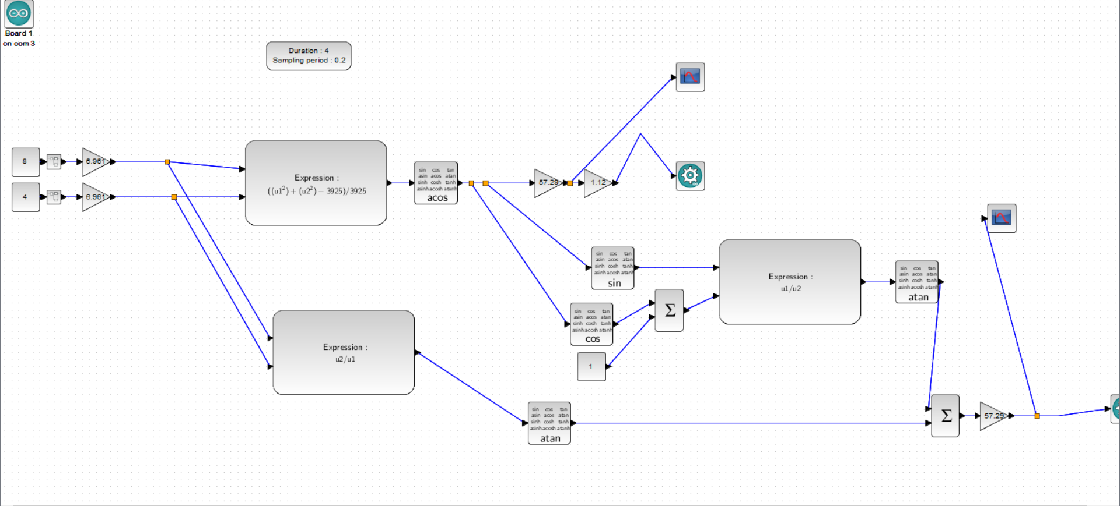
Block diagram

Slide 5
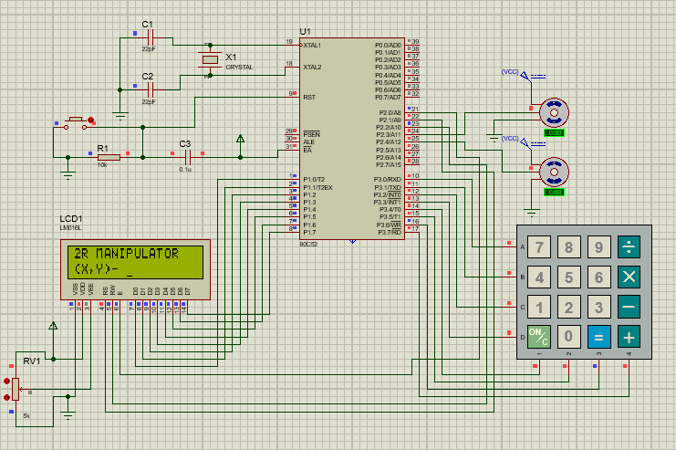
Proteus setup

Slide 6
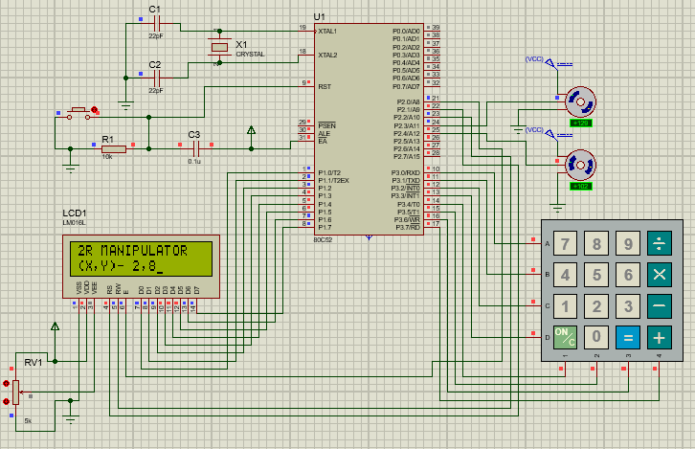
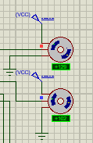
PROTEUS SIMULATION OUTPUT

